Slide 1



Skipline Project
View in Power BI
Last data refresh:
8/9/2024 10:36:07 AM UTC
Downloaded at:
8/9/2024 10:37:42 AM UTC

Slide 2
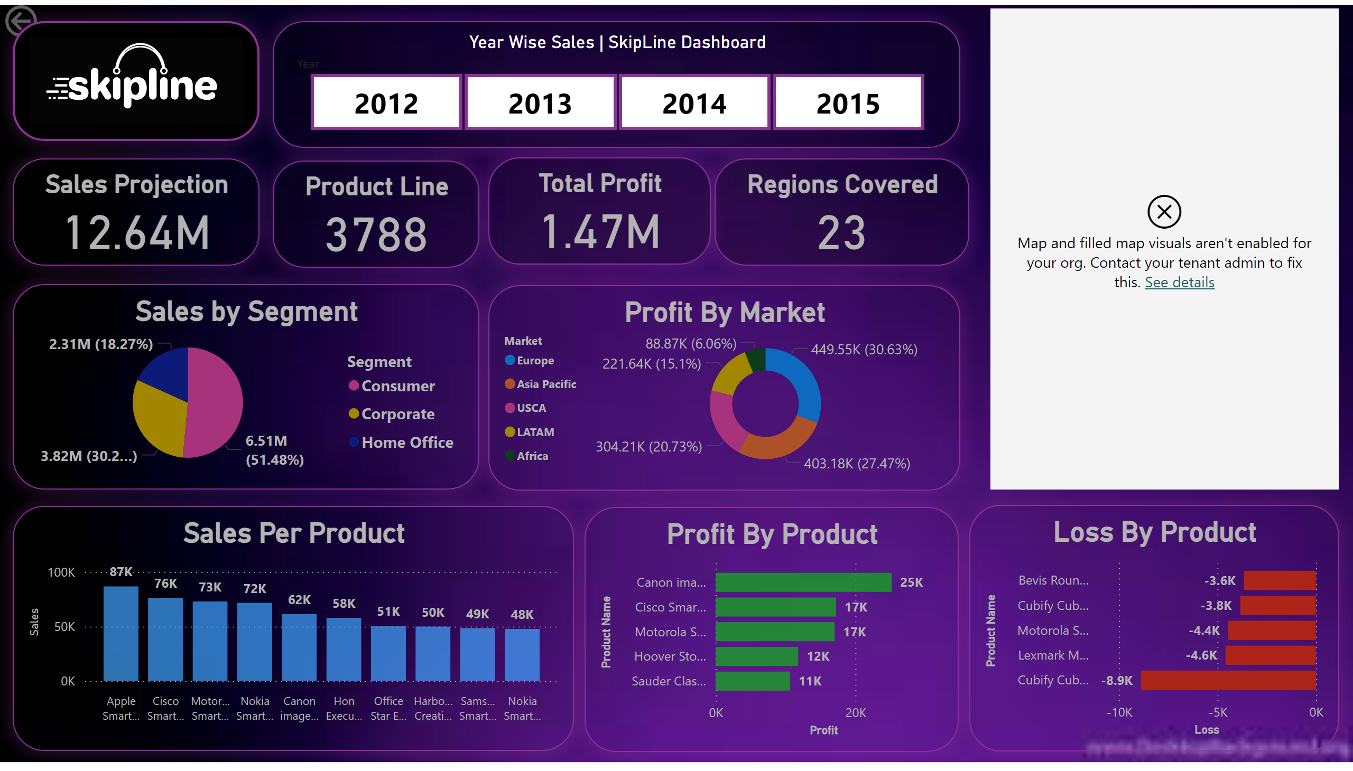
Report
Notes:
Year Wise Sales | SkipLine Dashboard
No alt text provided
Sales Projection
No alt text provided
Regions Covered
No alt text provided
Total Profit
No alt text provided
Product Line
No alt text provided
actionButton
No alt text provided
Sales by Segment
No alt text provided
Profit By Market
No alt text provided
Sales Per Product
No alt text provided
Profit By Product
No alt text provided
Loss By Product
No alt text provided
map
No alt text provided
image
No alt text provided

